Slide 1

Final Report Smart Robot
Smart Mobility Engineering Lab
Group - C

Slide 2
Contents
Introduction
Project Objective
Approach to the project
Procedure
Team meeting and discussion
Demo video and implementation
Team Members & Contribution

Slide 3
Team members (Group – C)
Sudip Dhungana – 12194823
Sanjib Tamang – 12194939
Ritik Deuja – 12194824
Keshav Adhakari - 12194874
Pradip Thapa- 12194940
Bijay pariyar- 12194945
Yusupov Elbek - 12194909

Slide 4
Roles & Contribution
Members | Contribution
Sanjib Tamang | Operating (Coding) and team tasks management ( To- keep everyone on the same page)
Sudip Dhungana | Publisher and Subscriber (Coding) for both tasks
Keshav Adhikari | Weekly GitHub Update
Pradip Thapa | Obstacle Detection (Client)
Ritik Deuja | Operating Action (Coding)
Bijay Pariyar | PowerPoint Management and Traffic Detection (Coding)
Yusupov Elbek | Presenter

Slide 5
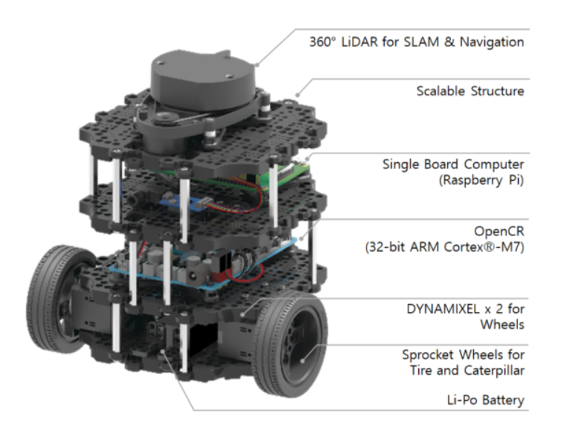
Introduction
A modern mobile robot that is modular, portable, and adaptable is the TurtleBot3 Burger.
Major Sensors and Actuators used are shown aside in the image.

Slide 6
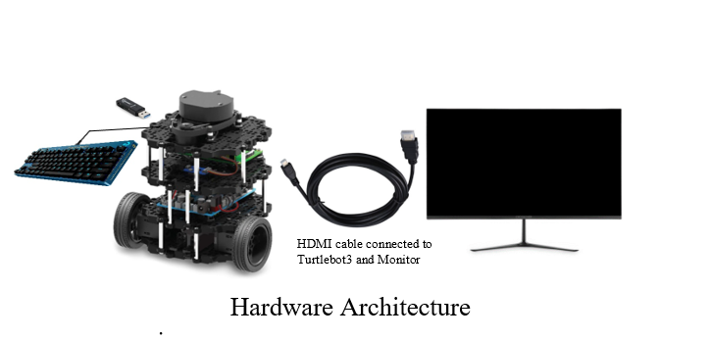
Hardware Architecture

Slide 7
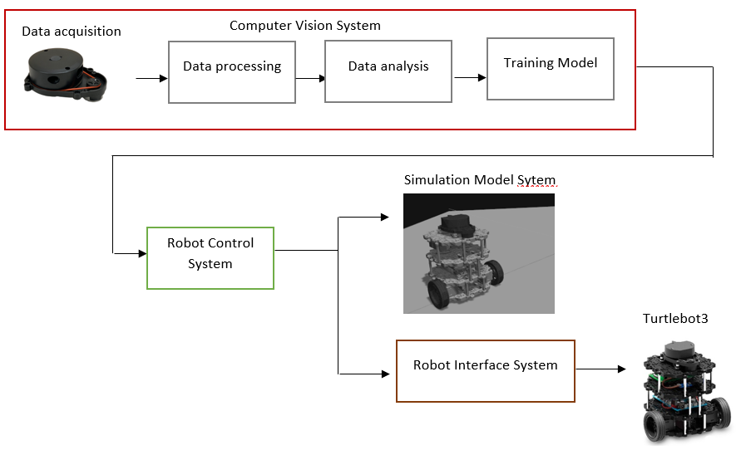
System
Structure
Overview
reference : https://www.researchgate.net/publication/335505212_Vision_Based_Control_for_Industrial_Robots

Slide 8
Project Objective / Proposal
The major goal of our project is to enable the Turtlebot3 to operate in autonomous driving mode that includes obstacle recognition, and traffic sign detection using ROS.

Slide 9
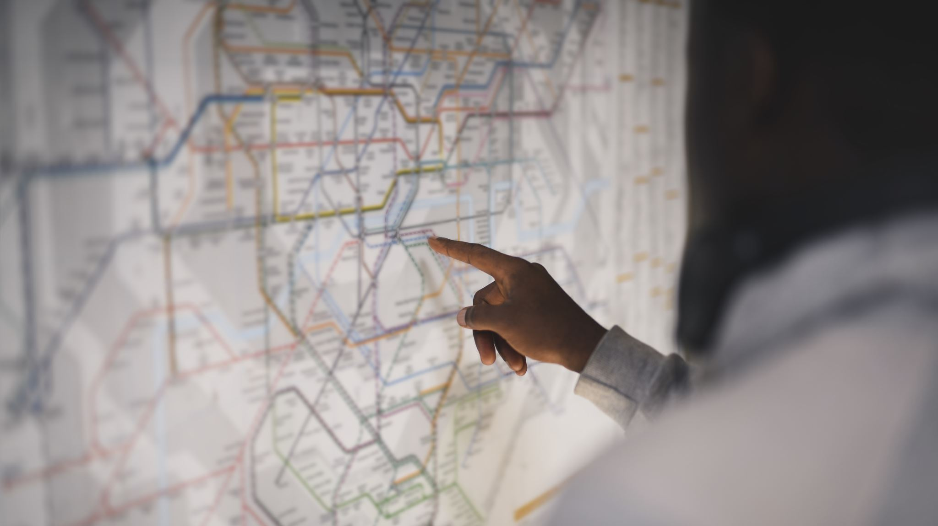
Approach to the project

Slide 10
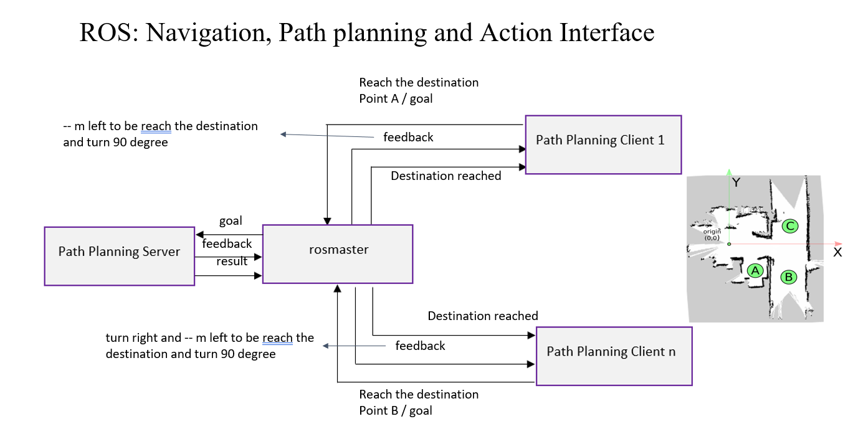
reference : https://wiki.nps.edu/pages/viewpage.action?pageId=1157791916

Slide 11
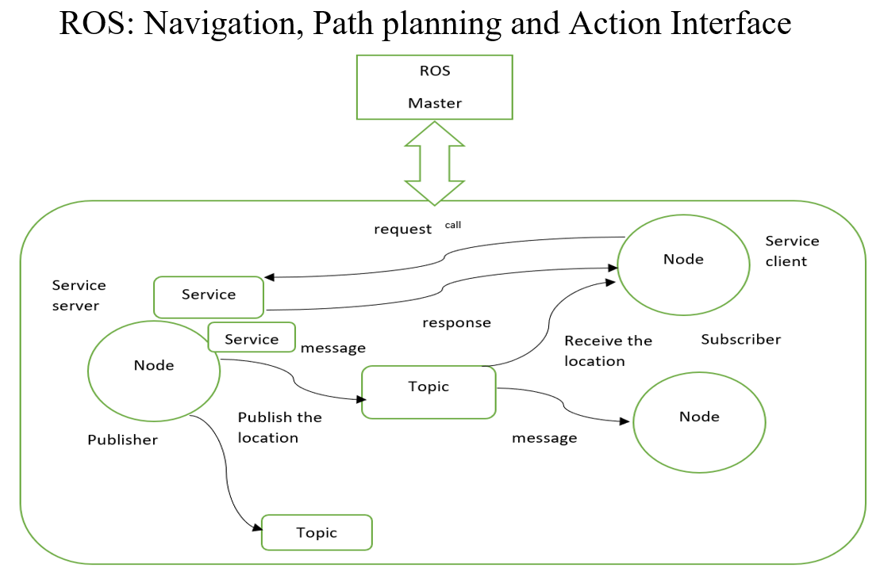
reference : http://akihikoy.net/notes/?text%2FROS%2FMinOverview

Slide 12
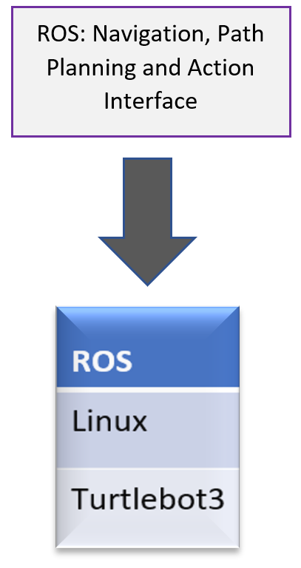
Experiment
Environment

Slide 13
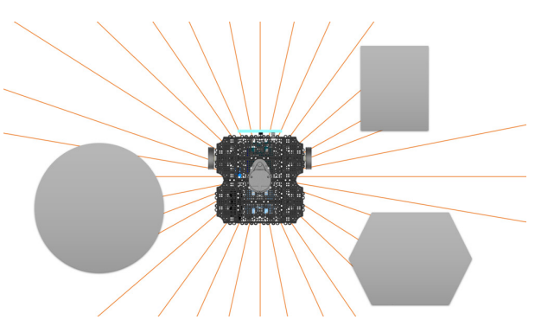
Utilizing LDS
SLAM (Simultaneous Localization And Mapping) is one of the most well-known applications of LDS. SLAM constructs a map by identifying barriers around the robot and estimating the robot's present position within the map as demonstrated in figure.
Obstacle detection of a robot using LDS

Slide 14
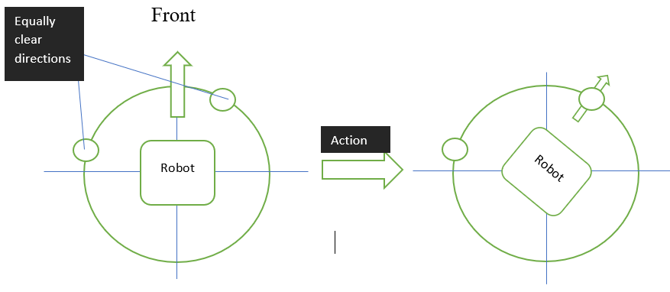
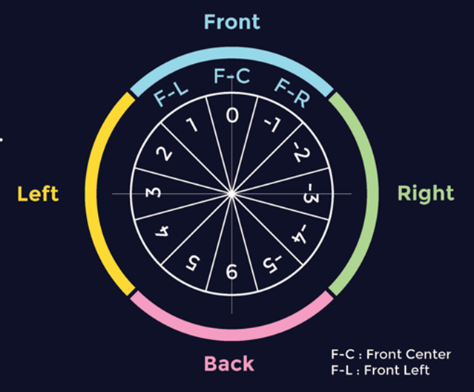
Utilizing LDS
Goal
Position the robot's front such that it faces the path that is the cleanest and produces the fewest detours.
Data processing
LiDAR technology offers 360-degree coverage. Four global areas made up of three local regions each make up the covered circle.
Each sub-integers regions represent the weight of the goal deviance (F-C). Each integer's sign specifies the robot's orientation with respect to the target (F-C).

Slide 15
Flow-chart of Obstacle Detection by Lidar Sensor
START
INPUT (emits radiation by Lidar sensor)
Receive the information
Data processing
Detection of obstacle
yes
No
Change the path
(left,right or backwards)
Follow the same path
reference : https://www.irjet.net/archives/V4/i2/IRJET-V4I2177.pdf

Slide 16
Proposed Traffic Light System Architecture
Turtlebot3
Raspberry pi camera
Raspberry pi 4
Program development using ROS
Red LEDs Yellow LEDs Green LEDs
Monitor
Keyboard
reference : https://www.researchgate.net/publication/359756848_Raspberry_Pi-Based_Intelligent_Traffic_Signal_Control_at_Intersections

Slide 17
Traffic Sign Detection Architecture
ROS
image acquisition ROS node
robot action detection ROS node
openCR
rosserial
camera
image processing ip
Robot control (velocity,angle)
image
motor
traffic light detection

Slide 18
Procedure
Installation of PC, SBC and OpenCR Setup of Turtlebot3
Run Nodes
Camera sensor installation
Autonomous Driving
Traffic Sign Detection
Obstacle Detection

Slide 19
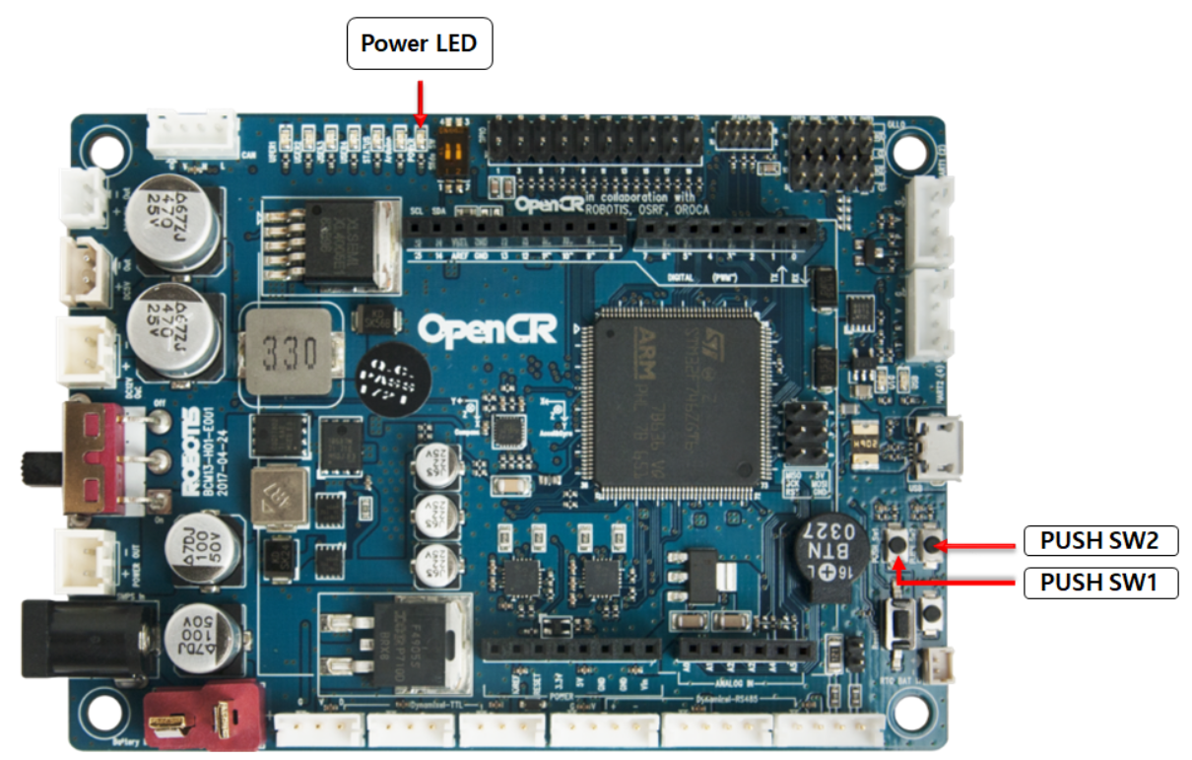
Errors
Open CR Test
Setup DYNAMIXELs for TurtleBot3

Slide 20
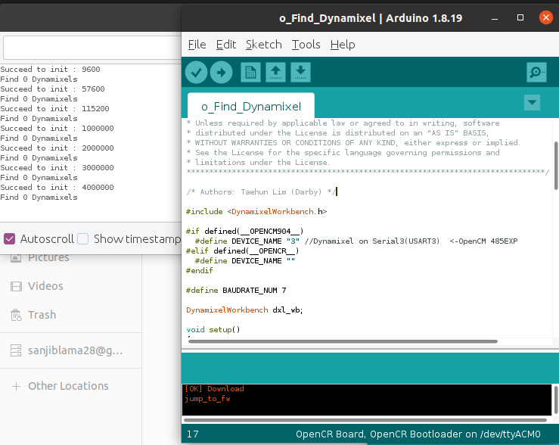
Errors
Open CR Test
o_Find_Dynamixel

Slide 21
Errors
Dynamixel Quick Guide for ROS 2

Slide 22
Experimental
setup of PC
 | Description
CPU | i7-12700
GPU | GTX 1650 ti
CUDA version | 11.6
CUDNN version | 8.5
TensorFlow version | 2.10.0

Slide 23
Experimental setup of turtlebot3
 | Description
Controller | Open CR
Interfaces | Raspberry PI
GPU | 32-bit ARM Cortex®-M7 with FPU
Sensors | LDS-01 /LDS-02
Motors | DYNAMIXEL (XL430-W250-T)/ (XM430-W210-T)
Camera
Remote Controllers | BT-410/RC-100B
IMU | Gyroscope 3 Axis Accelerometer 3 Axis

Slide 24
Team meeting and discussion
Week | Task | Location
9 | Team meeting and fixing idea | Star café
10 | Final proposal | Keshav’s Room
11 | Worked on the feedback provided by the professor | Zoom Meeting
12 | OpenCR Installation | Zoom Meeting
13 | SLAM | Keshav’s Room
14 | Autonomous Driving and Final Report | Sanjib’s Room

Slide 25
Project implementation
GitHub link of team : https://github.com/sanjiblama28/Smart_Team

Slide 26
GitHub Contents
Weekly Activities in the form of Readme File
Source Code for Object Detection and Traffic Sign Detection
Images

Slide 27
THANK YOU

